Slide 1
PROJECT PRESENTATION

Slide 2
IT INSTITUTE MANAGEMENT SYSTEM

Slide 3
Introduction
IT Institute Management System is software which is helpful for It institute authorities. In the current system all the activities are done manually. It is very time consuming and costly. Our It Institute Management System deals with the various activities related to the students And employee.

Slide 4


Features
Useful and fully featured IT Institute management system which will let you organize all aspects of your Institute.
Provides you a virtual environment from where you can control all the aspects of your teaching institution, classes, utilities and students.
Can access the record of the students quickly.
Can generate a pay slip and student certificate.
F

Slide 5
Start

Slide 6
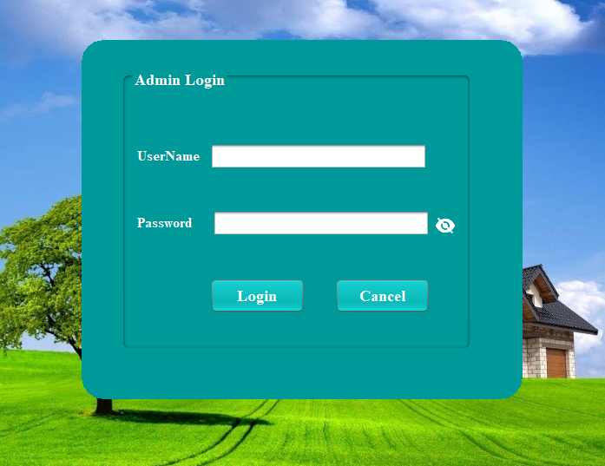
Login

Slide 7
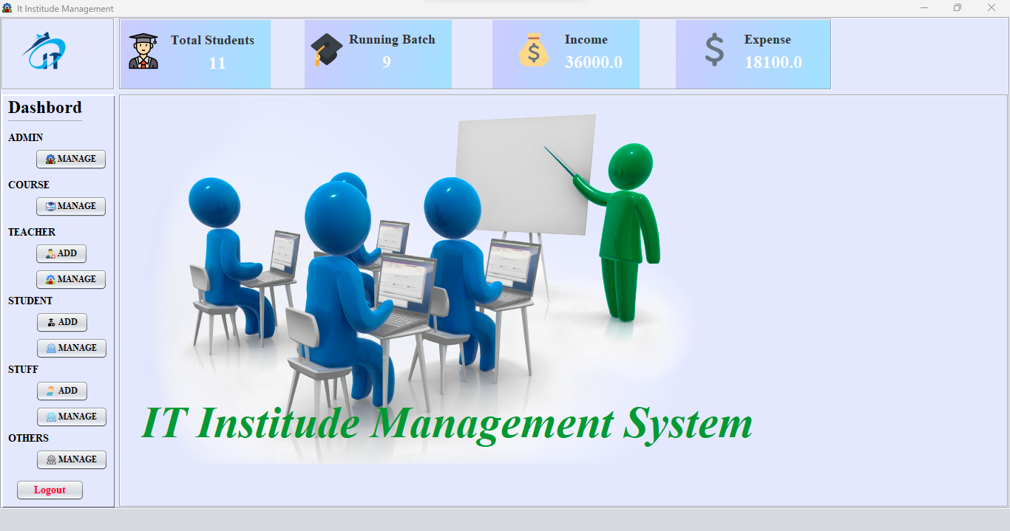
Dashboard

Slide 8
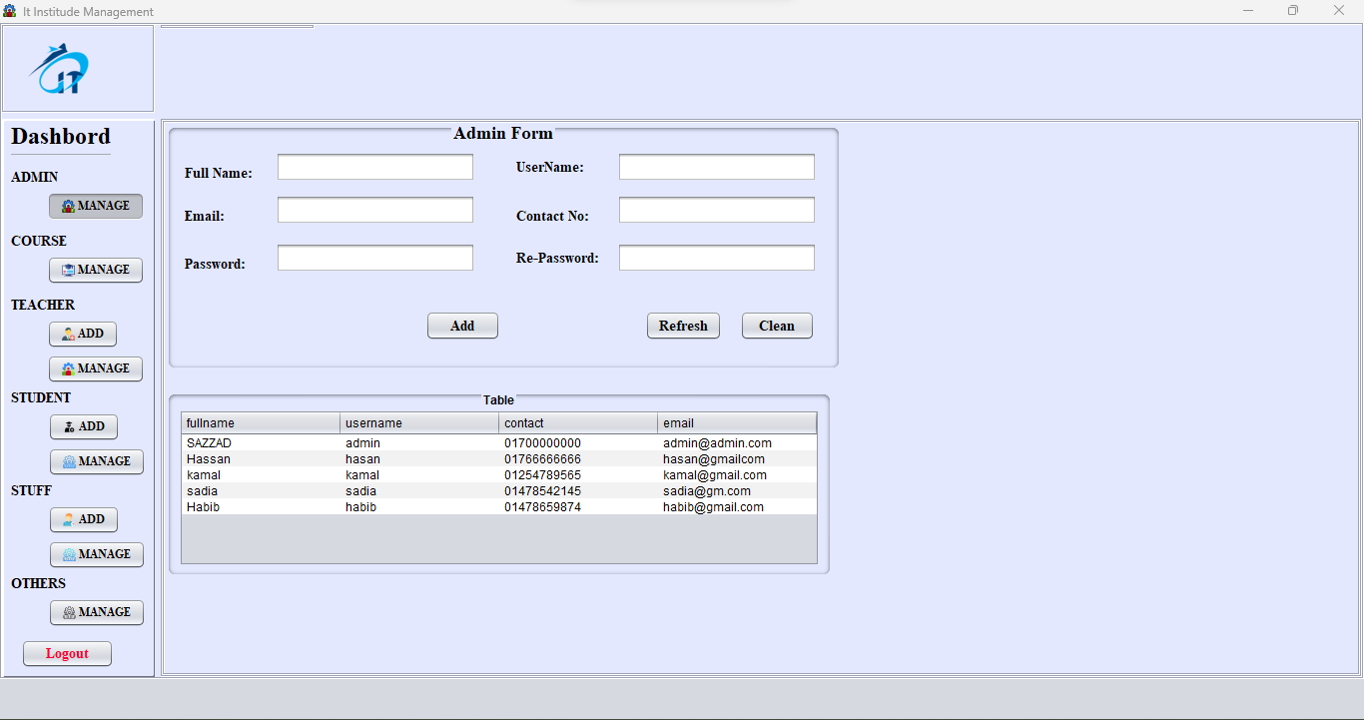
Add admin

Slide 9
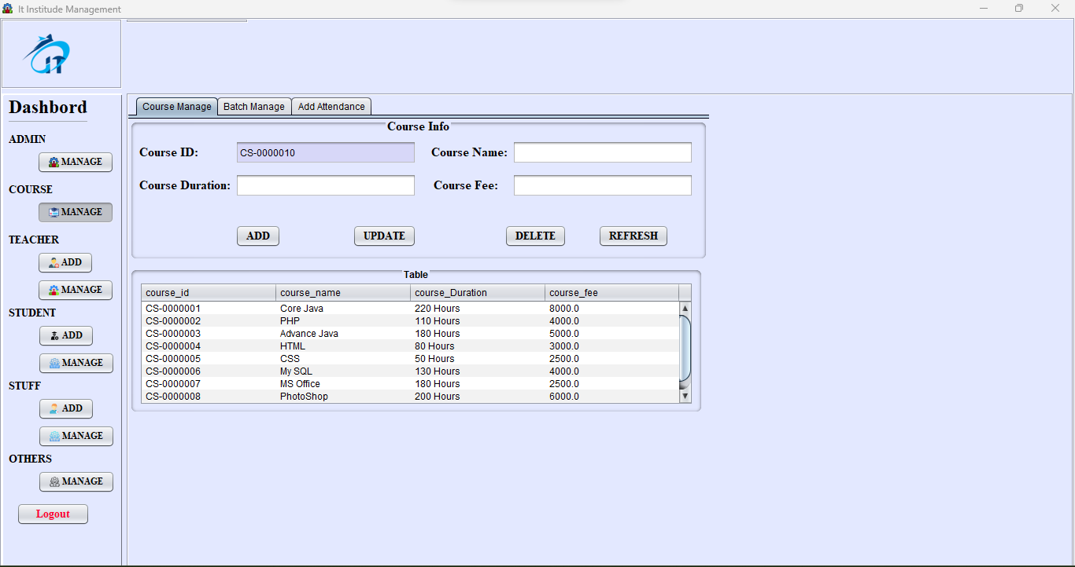
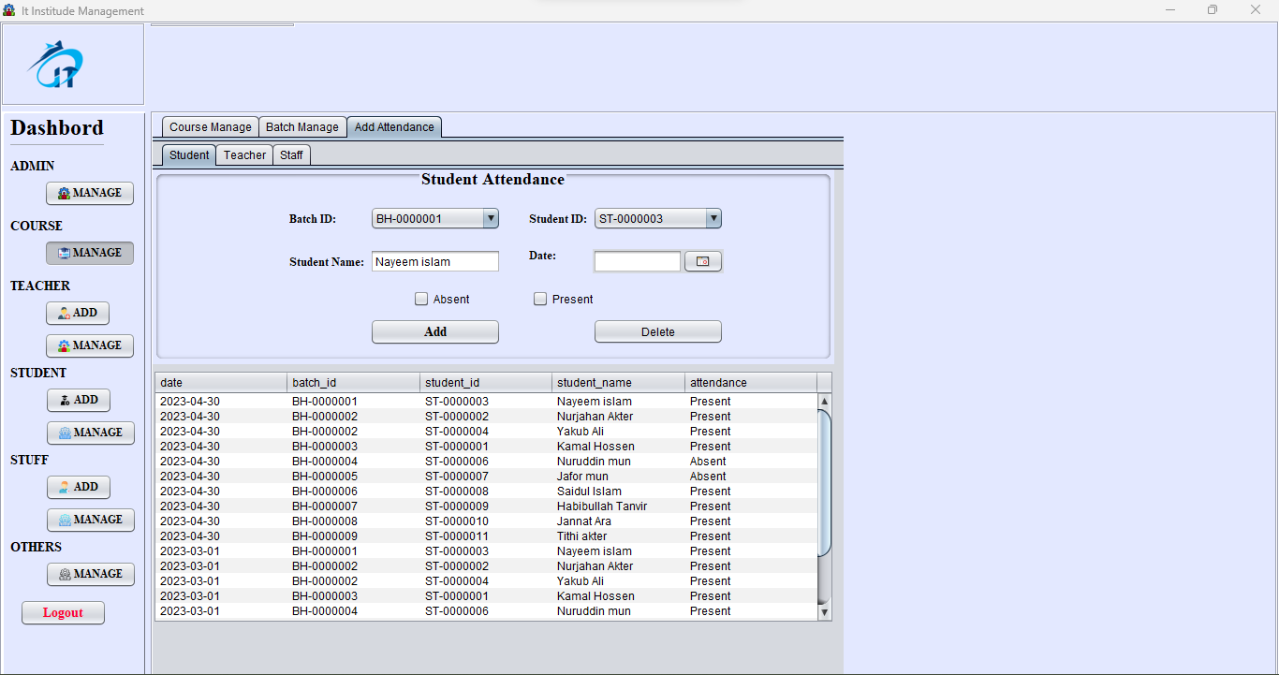
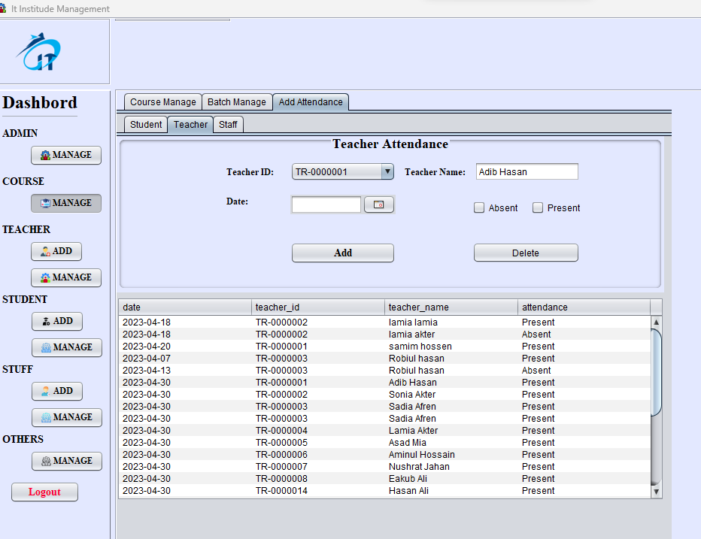
COURSE MANAGE
Add Course
Add attendance
Add Batch
All edit & delete

Slide 10
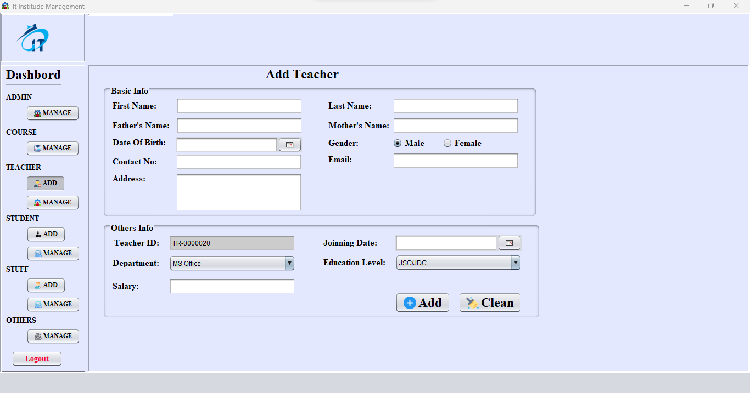
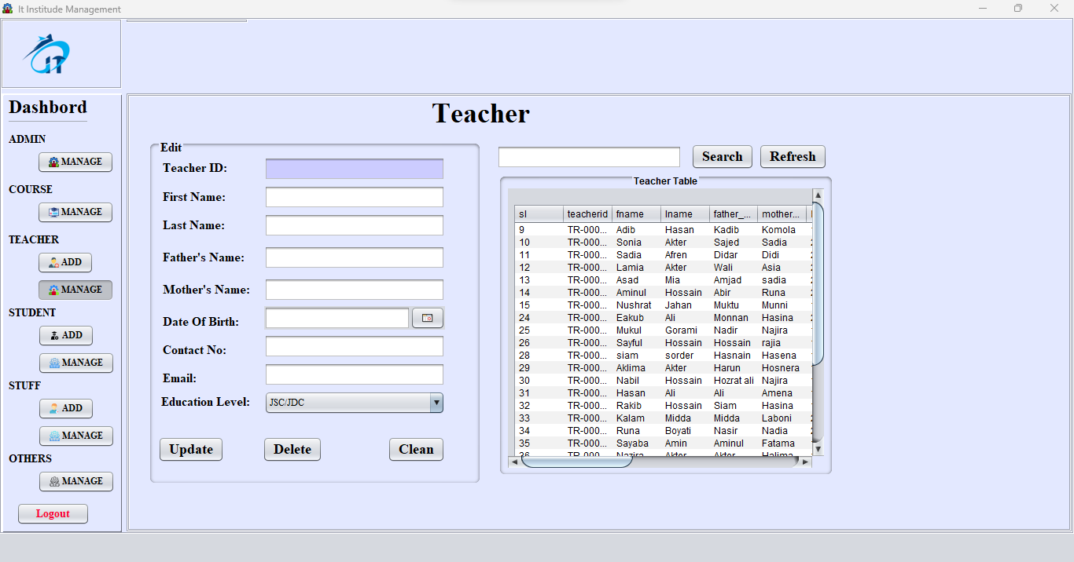
Teacher
Add Teacher Records
Manage Records
All edit & delete

Slide 11
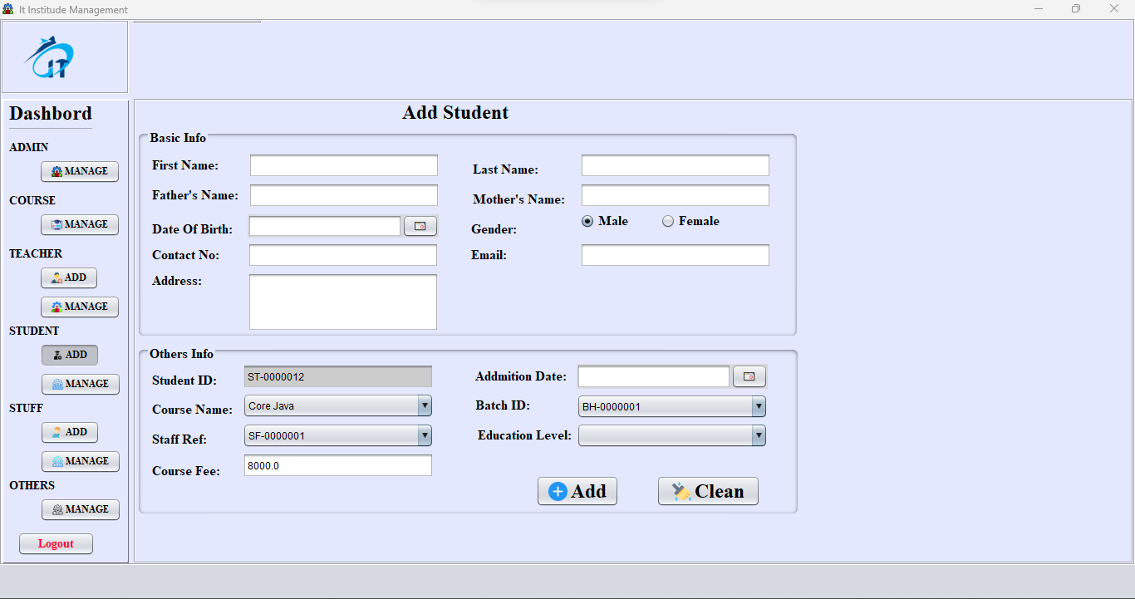
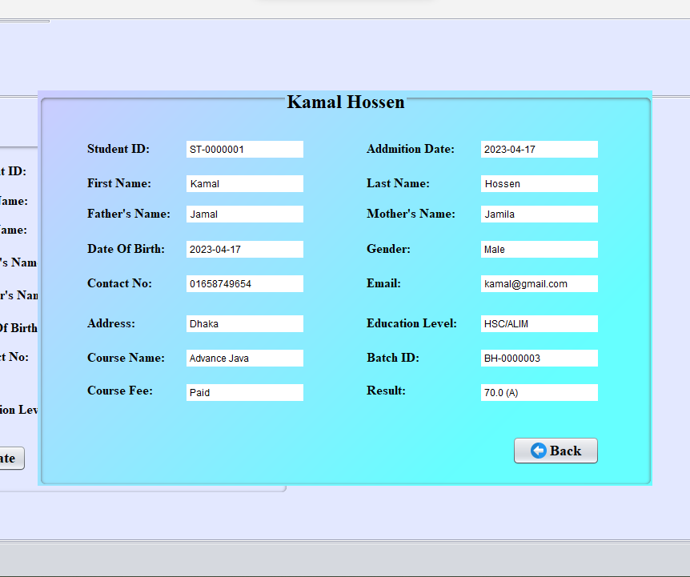
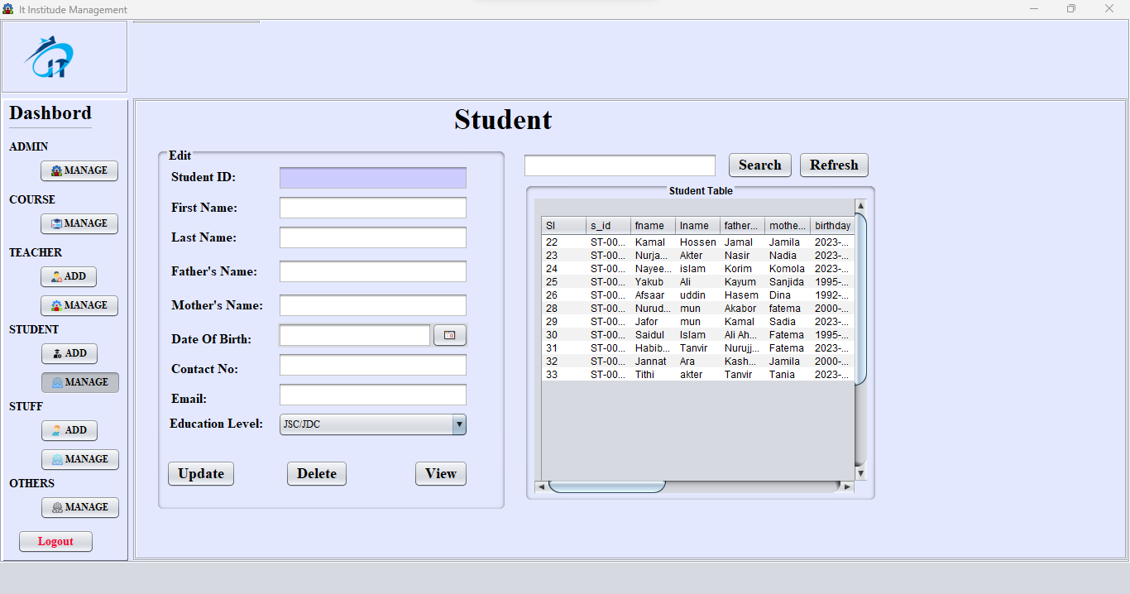
Student
Add Student Records
Manage Records
All edit & delete
View Student all InFo

Slide 12

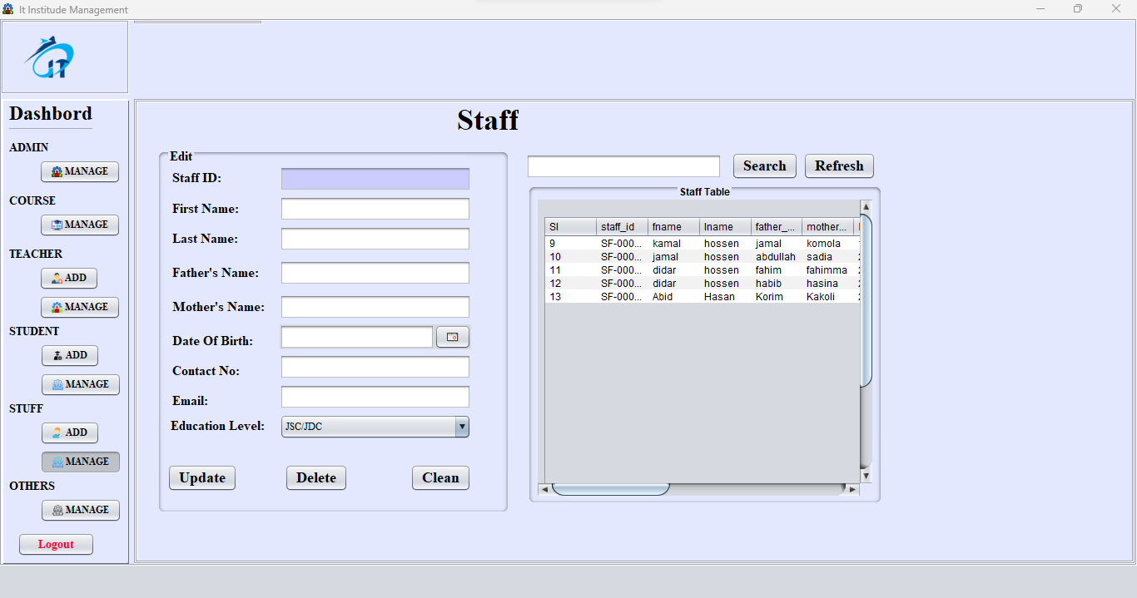
Staff
Add Staff Records
Manage Records
All edit & delete

Slide 13
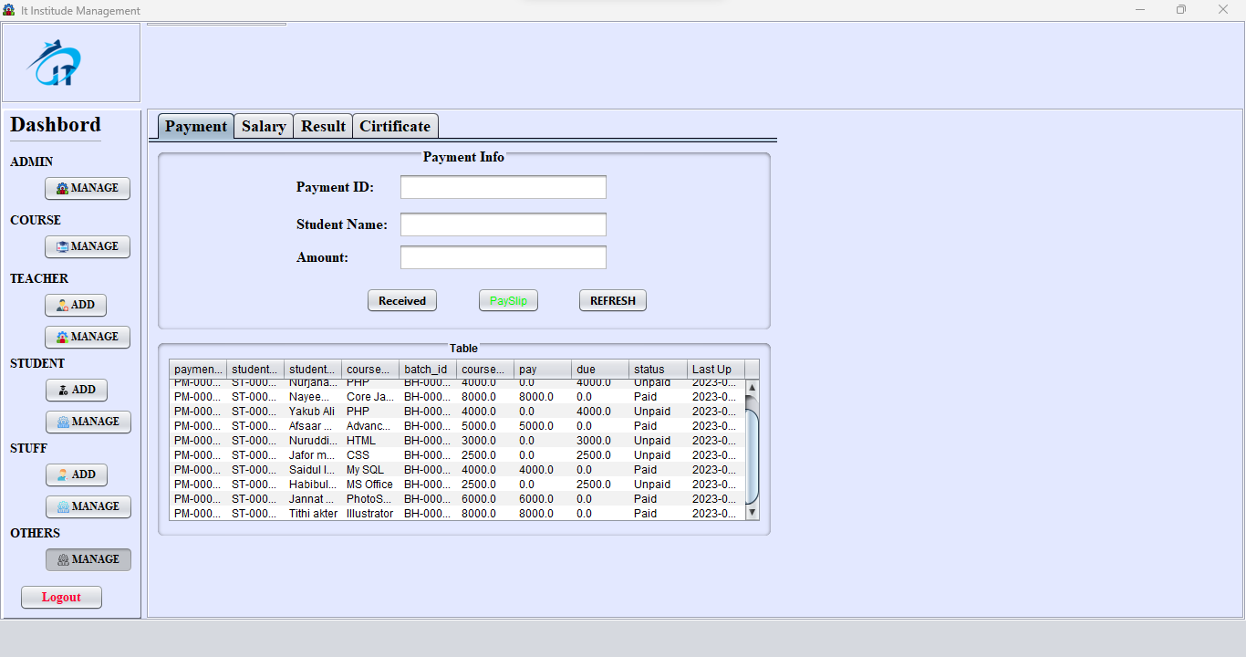
Course Fee Received

Slide 14
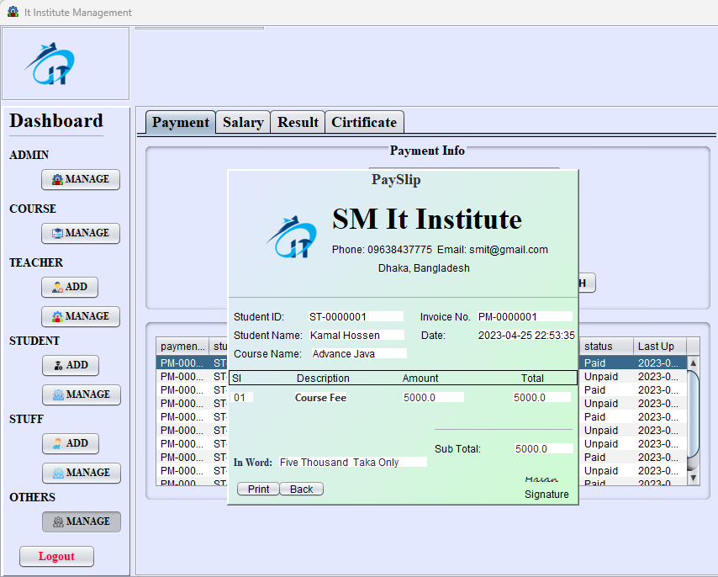
Print pay slip

Slide 15
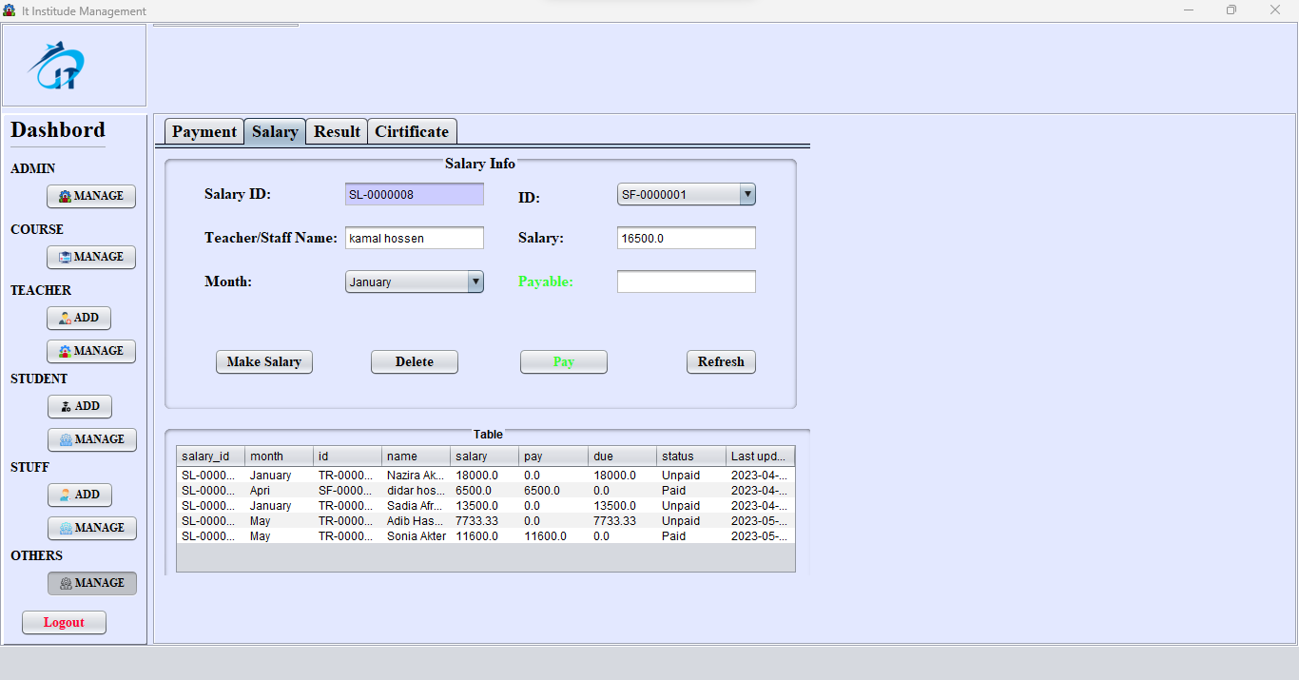
Teacher Salary pay

Slide 16
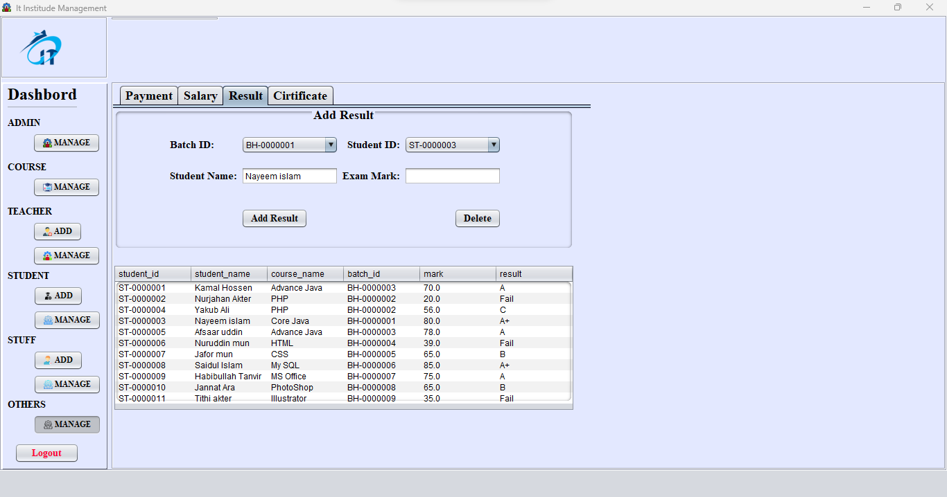
Add Student Result

Slide 17
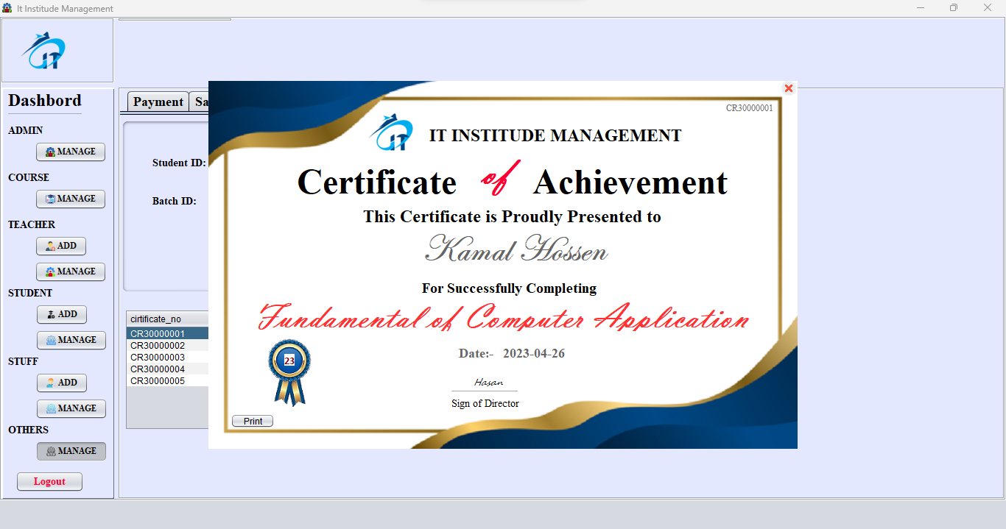
Print Certificate

Slide 18
END
Mahmudul Hasan
ID: 1272023

